Slide 1
Optimizing Fire Station Coverage to Minimize Emergency Response Times in Logan City

Slide 2

Problem Statement
Emergency response times are critical for saving lives and protecting property. In Logan City, ensuring that all areas have adequate fire station coverage is essential to meeting response time targets. Currently, some high-risk or high-population zones may fall outside optimal response time limits, leading to delays in emergency services. This project seeks to address this by optimizing the coverage and dispatch strategy of fire stations in Logan.
Source: YouTube @ Police Roleplay Community

Slide 3
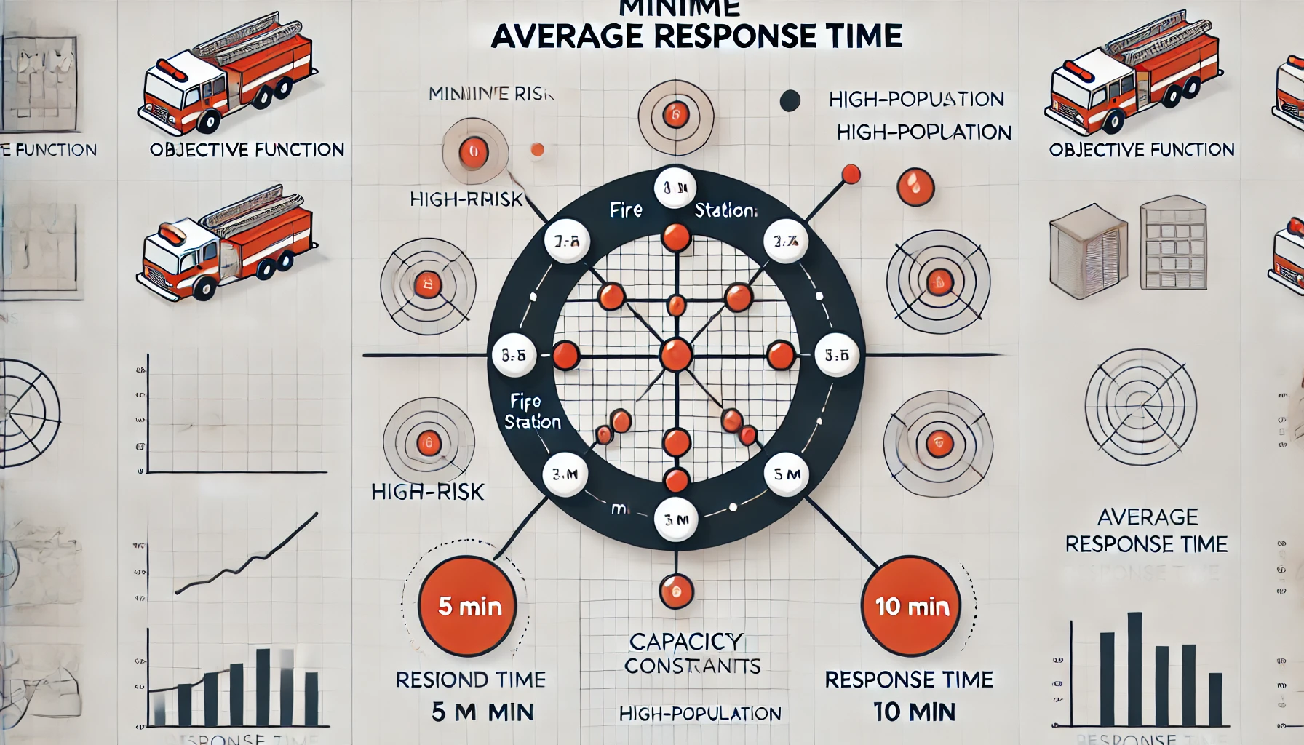
Key Ideas and Approach
GIS-Based Analysis for Coverage and Gaps: Using Geographic Information Systems, I will map the existing fire stations and analyzed coverage areas based on estimated travel times. By creating service area buffers at various travel-time intervals (e.g., 5, 10, and 15 minutes), then I will identify zones that are underserved by current fire station locations. This helps visually locate coverage gaps, particularly in high-demand areas.
Optimization Model : The core of this project is a Linear Programming (LP) model formulated to minimize average response time across all zones. The model assigns high-priority demand zones to nearby fire stations while incorporating constraints:
Coverage Requirement: Each high-priority zone must be within reach of at least one fire station within the set response time.
Capacity Constraints: Each fire station has a limited number of vehicles or personnel, ensuring balanced coverage across stations.
Response Time Limit: The model restricts coverage to zones reachable within a target response time, ensuring rapid emergency response where needed most.
Scenario Testing and Sensitivity Analysis: By adjusting parameters such as fire station capacities and maximum allowable response times, the model tests different scenarios to recommend potential new fire station locations or reallocate resources for improved coverage.

Slide 4
Key Aspects of Model Formulation
Objective Function: The LP model seeks to minimize the total or average response time across all zones, prioritizing high-risk and high-population areas.
Coverage constraints ensure each demand zone is within the response range of a fire station.
Capacity constraints manage the workload for each station.
Response time constraints guarantee compliance with response time goals.
This optimization approach offers Logan City a data-driven solution to improve emergency response efficiency. The project identifies specific high-demand areas that may benefit from new or reallocated fire station resources, ensuring faster response times and enhanced public safety.

Slide 5

Thank you
Shailendra Khanal
s.khanal@usu.edu

